Slide 1
UML Lesson # 4
SEQUENCE DIAGRAM

Slide 2
UML ::: INTERACTION DIAGRAMS
An interaction diagram models communication behavior of individuals exchanging information to accomplish some task.
Sequence diagram—shows interacting individuals along the top and message exchange down the page.

Slide 3
Sequence Diagram Frames
Frame—a rectangle with a pentagon in the upper left-hand corner called the name compartment.
sd interactionIdentifier
interactionIdentifier is either a simple name or an operation specification as in a class diagram

Slide 4
Lifelines
Participating individuals are arrayed across the diagram as lifelines:
Rectangle containing an identifier
Dashed line extending down the page
The vertical dimension represents time; the dashed line shows the period when an individual exists.

Slide 5
Lifeline Creation and Destruction
An new object appears at the point it is created.
Not clear from UML specification
A destroyed object has a truncated lifeline ending in an X.
Persisting objects have lifelines that run the length of the diagram.

Slide 6
Lifelines Example

Slide 7
Lifeline Identifier Format
name[ selector ] : typeName
name—simple name or “self”; optional
selector—expression picking out an individual from a collection
Format not specified in UML
Optional; if omitted, so are the brackets
typeName—Type of the individual
Format not specified in UML
Optional; if omitted, so is the colon
Either name, typeName, or both must appear

Slide 8
Lifeline Identifier Examples
player[i] : Player
player[i]
: Player
board

Slide 9
Self
Used when the interaction is “owned” by one of the interacting individuals

Slide 10
Messages and Message Arrows
Synchronous—The sender suspends execution until the message is complete
Asynchronous—The sender continues execution after sending the message
Synchronous message return or instance creation

Slide 11
Message Arrow Example

Slide 12
Message Specification Format
variable = name argumentList
variable—name of variable assigned a result
Optional; if omitted, so is the equals sign
name—simple name of the message
argumentList—list of arguments in parentheses
varName = paramName
= paramName may be omitted
paramName = argumentValue
= argumentValue may be omitted
—
Optional; parentheses may appear even if omitted
Message specification may be * (any message)

Slide 13
Message Specification Examples
hello
hello()
msg = getMessage( helloMessage )
x = sin( a/2 )
x = sin( angle = a/2 )
trim( result = aString )
Note that assigning a value to a parameter and assigning a returned value to a variable cannot be distinguished.

Slide 14
Execution Occurrences
An operation is executing when some process is running its code.
An operation is suspended when it sends a synchronous message and is waiting for it to return.
An operation is active when it is executing or suspended.
The period when an object is active can be shown using an execution occurrence.
Thin white or grey rectangle over lifeline dashed line

Slide 15
Execution Occurrence Example

Slide 16
Sequence Diagram Heuristics 1
Put the sender of the ﬁrst message leftmost.
Put pairs of individuals that interact heavily next to one another.
Position individuals to make message arrows as short as possible.
Position individuals to make message arrows go from left to right.

Slide 17
Sequence Diagram Heuristics 2
Put the self lifeline leftmost.
In a sequence diagram modeling an operation interaction, draw the self execution occurrence from the top to the bottom of the diagram.
Name individuals only if they are message arguments or are used in expressions.

Slide 18
Sequence Diagram Heuristics 3
Choose a level of abstraction for the sequence diagram.
Suppress messages individuals send to themselves unless they generate messages to other individuals.
Suppress return arrows when using execution occurrences.
Don’t assign values to message parameters by name.

Slide 19
Using Sequence Diagrams
Sequence diagrams are useful for modeling
Interactions in mid-level design;
The interaction between a product and its environment (called system sequence diagrams);
Interactions between system components in architectural design.
Sequence diagrams can be used as (partial) use case descriptions.

Slide 20
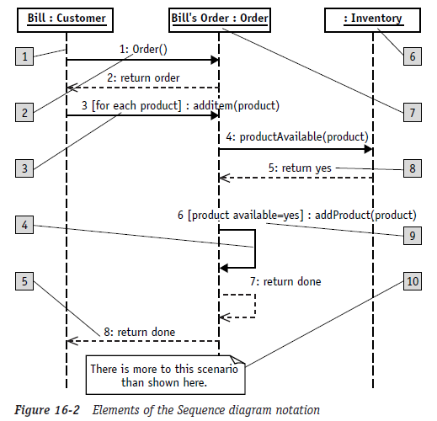
ELEMENTS
The reference numbers on the
figure denotes:
Object lifeline
Message/Stimulus
Iteration
Self-reference
Return
Anonymous object
Object name
Sequence number
Condition
Basic comment

Slide 21
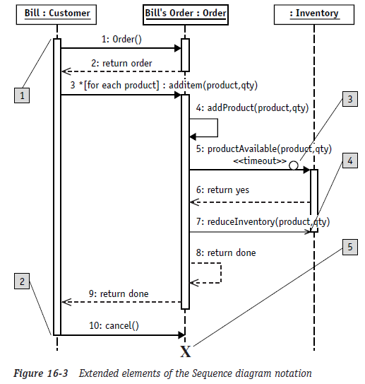
Elements (extended)
Activation:
The start of the vertical
rectangle, the activation bar
Deactivation:
The end of the vertical
rectangle, the activation bar
Timeout event:
Typically signified by a full
arrowhead with a small clock
face or circle on the line
Asynchronous event:
Typically signified by a stick
arrowhead
Object termination
symbolized by an X

Slide 22
-: EXAMPLES :-

Slide 23
On-Line Stockbroker – Use Cases for Stock Purchase
Successful purchase
Unsuccessful purchase attempt
customer
Notes:
These two use cases are essentially two scenarios; so lets sketch the scenarios and then show how they are implemented.

Slide 24
On-Line Stockbroker Scenarios
Successful purchase of stock
Un-successful purchase of stock – inadequate funds available

Slide 25
Description of Scenario 1
User logs in
Selects the stock he wishes to purchase
Specifies how much stock he wants to buy
Specifies the limits on the price he is willing to pay
Places order
System responds with details of successful purchase

Slide 26
Class Diagram
People
Web Interfaced Computer System
Customer
Stockbroker System
SecuritiesExchange
Notes:
NB. This example only very superficially explains how the Scenario works. The design would have to be worked out in much greater detail at a later time and then a more complex Class Model would be necessary as the Sequence Diagrams depend on having classes pre-defined.

Slide 27
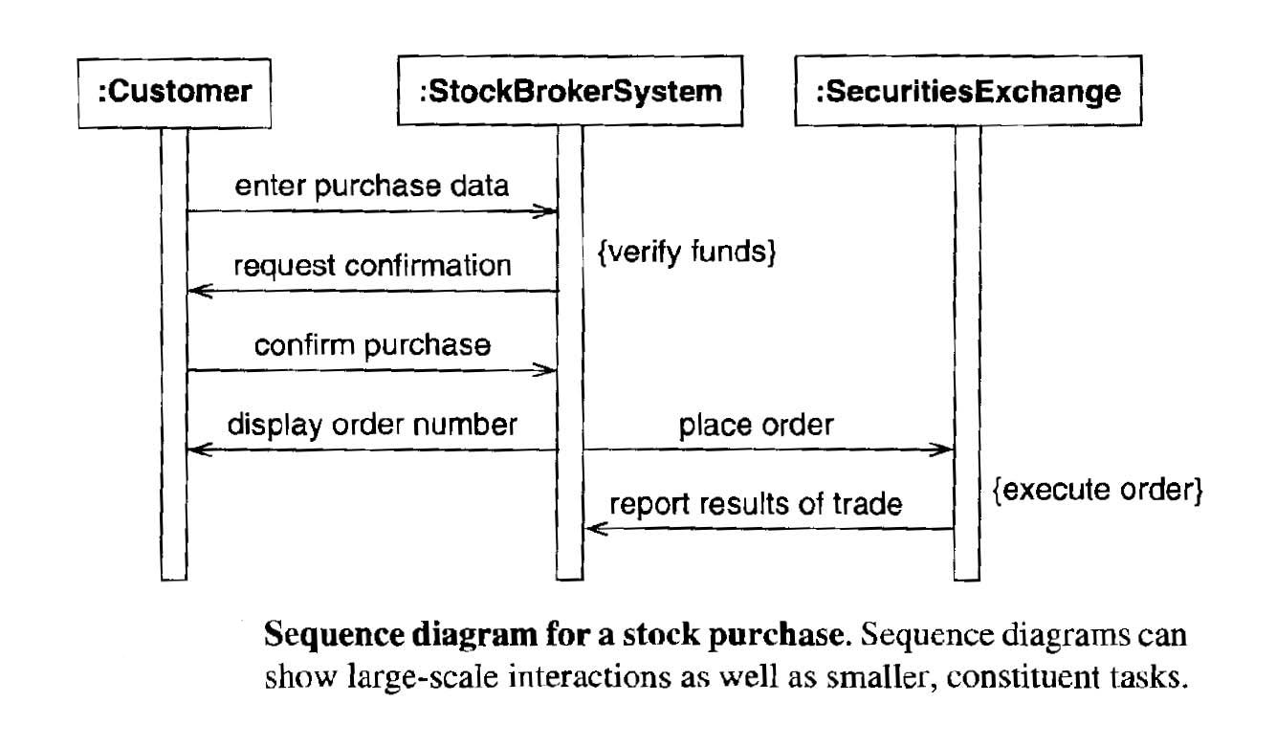
Sequence Diagram for Stock Purchase

Slide 28
Description of Scenario 2: Un-successful purchase of stock – inadequate funds available
User logs in
Select stock he wishes to purchase
Specifies how much stock he wants to buy
Specifies limits on the price he is willing to pay
Place order
Order rejected due to lack of funds
Delete order
Notes:
The class Model as so far defined will not allow the description of loggin in Select Stock etc. So it is just a superficial sequence diagram that follows.

Slide 29
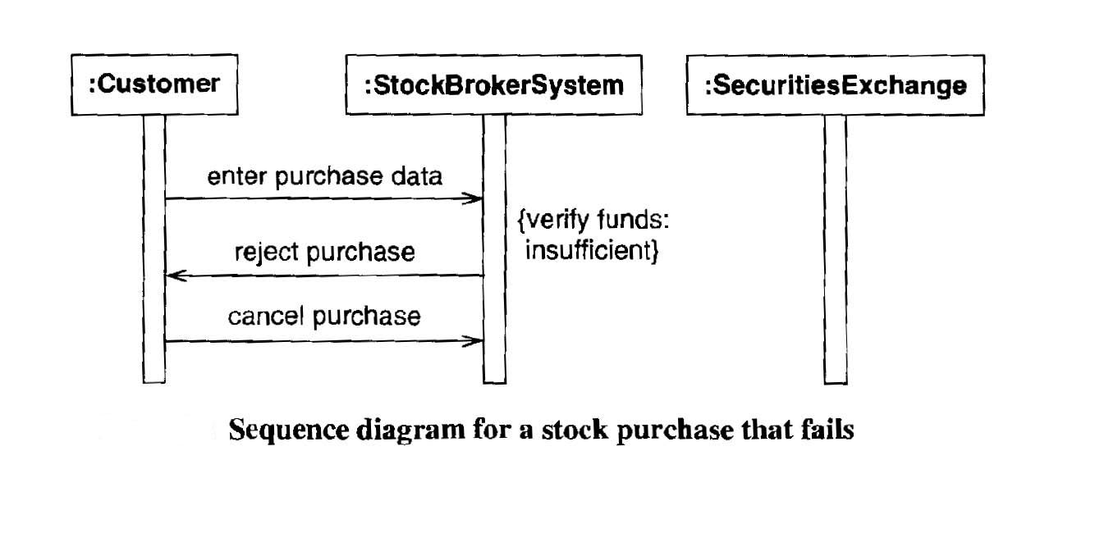
Un-successful purchase of stock – inadequate funds available

Slide 30
Electric Kettle Design Scenario 1 kettle boils after cut out due to no water
User
Boils water
Fills with water
Notes:
We are now going to look at the way the set of diagrams develops to explain just enough of the design of the kettle to explain one use case or scenario.
The kettle will, of course, have several other use cases but we ignore them as they are not necessary for our present purpose.

Slide 31
Scenario 1: Boil Water but – no water
User turns on switch
Water heats up and boils
Element overheats and cuts out
User adds more water
Cut out cooled sufficiently to re-connect
User turns on switch
Water boils
Notes:
Now we understand this scenario we can list the objects/classes necessary to explain how it happens.
We need switch, water, heating element, fuse

Slide 32
Develop relevant Class Diagrams We need switch, water, heating element, cut-out
Electric Heater
Energy source
Power rating
Heater
Energy source: electricity
Provides heat
Provides heat
Electric Element
Liquid
temperature
Provides heat to
Cut-out temperature
Cut-out
reset
Notes:
This set of diagrams were developed in the lecture on Classes. We need an element and a liquid: water
We need various properties for the element ie temperature and cut-out temperature
And we need two new methods for the element: cut-out and reset.

Slide 33
We need Water and Switch
liquid
Boiling point
Latent heat of vaporisation
boiling
Water
Switch
State = [ On or Off]
Boiling point = 100ºC
Allows current to flow or not

Slide 34
Sequence Diagram for Scenario 1
User
{Loop until cut-out or boils}heat
Switch on
Activate
{loop} update temperature
{Loop} update temperature
Check cut-out temperature
Notes:
Now this diagram is not entirely satisfactory if you are a programmer but if you are a designer then you will not want lots of detail and this will be enough to explain how the system works.
We could have added a cut-out as a separate object and sent messages to it and its associated thermostat.
Not that we have not completed the scenario as described in an earlier slide as the scenario requires us to go back to the user and get him to fill the kettle and switch the kettle on again. Most of this is outside the system and so I have decided to change the definition of the scenario to exclude this part. See next slide.

Slide 35
Update Scenario 1: Boil Water but – no water
User turns on switch
Water heats up and boils
Element overheats and cuts out
End here and delete the rest of the scenario
User adds more water
Cut out cooled sufficiently to re-connect
User turns on switch
Water boils
Notes:
Now we understand this scenario we can list the objects/classes necessary to explain how it happens.
We need switch, water, heating element, fuse

